Slide 1
NORD POOL SPOT UPDATE
Baltic Electricity Market Miniforum
Hando Sutter
September 21st, 2012

Slide 2

Our function
To provide liquid, secure power markets
To provide accurate information to the whole market, ensuring transparency
To provide equal access to market for everyone wanting to trade power
To be the counterparty for all trades; guaranteeing settlement and delivery
Notes:
2
2

Slide 3
New shareholders
From August Litgrid and Elering are new shareholders of Nord Pool Spot
AST has an option to join
One seat in Nord Pool Spot board is given to Baltic representative in rotating bases

Slide 4
Current situation
NPS price area in Estonia (since April 1st, 2010)
  Energy form Russia can enter the market only via PEX
  No real trade on RU-EE border
  New EE/LV boarder capacity allocation scheem was introduced from June 18, 2012
Latvia – no PEX implemented yet
  Nord Pool Spot has received an invitation to start the preparations for Latvian bidding area opening
  Project start up is pending on NRA preliminary decision expected in September.
Lithuania: NPS price area was opened on June 18th.
  Lithuania works as an isolated area having CB setup on LV, KAL and BY boarders.
  Energy from third countries enters the market via PEX, but these bids are not taking count on price formation (mostly price independent bids)

Slide 5
Lithuanian update
Opening of Lithuanian NPS bidding area was signed on March 26th, 2012, same day it was published to the market.
Lithuanian planned CB setup was introduced to Baltic TSO’s on the meeting in February 2012.
Changes in the trading rules were announced through exchange information system on April 17th, 2012
Lithuanian opening project went according to the plans and first trading day was June 18th, 2012
Currently 23 members are trading in LT area
Litgrid started to publish 3rd countries planned flows in July
Feedback from Lithuanian participants, TSO and NRA has been positive.

Slide 6
Separated LT bidding area setup
-Bids from LV/ELE and KAL are handled through dedicated portfolios
-On BY/LT boarder export/import areas are established
-Bidding currency is EUR

Slide 7
Estonian update
On February 17th, 2012 after introduction on Baltic TSO’s meeting Elering issued to NPS a request to change established CB setup on EE/LV boarder from May 15th, 2012
Due to technical reasons it was agreed to implement CB change together with Lithuanian area opening on June 18th.
An exchange information was issued on March 26th, 2012, changes in the trading rules were published on April 17th.
EE/LV new cross boarder solution was also introduced in Market Council and to the regulator receiving no suggestions or negative feedback.
After the implementation there has been almost constant congestion on EE/LV boarder, causing price difference between EE and ELE areas.
There have been reduced capacities on EE/ELE boarder through the summer

Slide 8
EE/LV CB setup change from June 18th
Finland (FI)
Finland (FI)
Estonia (EE)
Estonia Russia
Import area (ERI)
Estonia (EE)
Estonia Russia
Import area (ERI)
Estonia
Latvia Import area (ELI)
Estonia Latvia Export area (ELE)
Estonia Export and Import area
(ELE)
* ERI stays as before

Slide 9
Latvian update
Several changes to the Electricity legislation in Latvia were approved in the parliament in July 2011
Based on the current understanding the legislation includes necessary changes in order for Nord Pool Spot to function as a power exchange in Latvia
Establishment decision for market implementation will be made at the time EC certification procedure is finalized and the ISO solution is approved. Some preparations may start after NRA prelimenary decision.
6 months time of notice from the information to the market
Elspot-market opening can hopefully take place in Q2 2013
  Start time and time required for the certification is uncertain
  Common preparation and planning of the establishment can be started during the final certification procedure

Slide 10
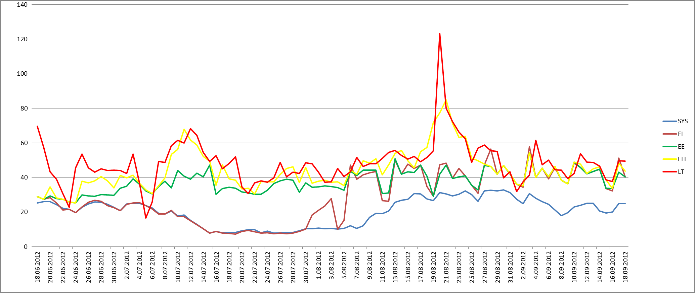
Price dynamics since June 18th, 2012

Slide 11
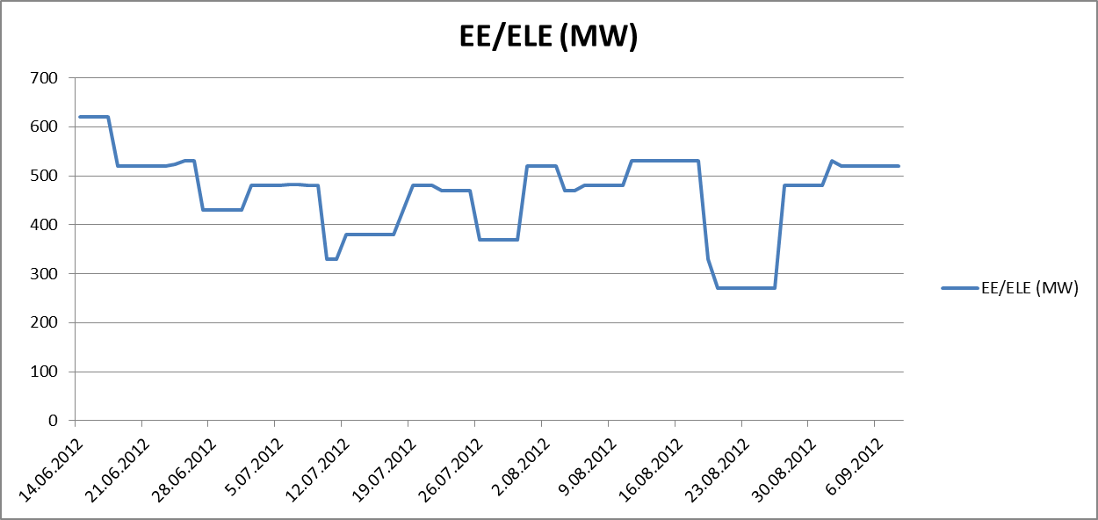
Allocated capacity on EE/LV boarder
270 MW!

Slide 12
Conclusions after June 18th
All the active participants of Baltpool switched over to Nord Pool Spot
Average daily price June, July Aug (EUR):
- LT: 44,9 45,8 54,1
- ELE: 32,6 42,6 51,2
- EE: 30,8 35,9 40,3
Most of the days price formation and the flows between the areas has been logical
Capacity reduction on EE/LV boarder has been creating almost constant congestion. Estlink has been congested as well.
As there is no direct linkage between ELE and LT areas the arbitrage is set by major market players, having therefore very high responsibility on price formation.
Volumes in LT area quite a stable 20,000+ MWh/day, on ELE area has been higher than EE area,
As introduced market setup clearly draws out the challenges on the Baltic energy market, there has been lots of feedback both to NPS, TSO’s and NRA’s

Slide 13
Further challenges
Latvian bidding area opening or another intermediate solution
Common cross boarder capacities calculation principles (TSO’s)
3rd countries boarder handling mechanism
Intraday market start up in Baltics; common balancing energy price calculation principles
Further training of market participants (bidding behaviour, UMM’s etc.)
Improving the quality of the market in co operation with NRA’s and TSO’s
Financial market opening in Baltics – Nasdaq OMX

Slide 14
Baltic markets integration development
1
2
3
Current capacity allocation principles,
except changed EE/LV boarder setup
Capacity allocation in Lithuania performed by NPS
Internal Baltic capacities allocated by implicit auction
Agreement between Baltic TSO`s is required
Internal Baltic capacities allocated by implicit auction
Common capacity allocation rules for trade from 3rd countries
Agreement between Baltic TSO is required

Slide 15



Thank You!
Hando Sutter
hando.sutter@npspot.com

